Slide 1

WIPRO NGA Program – 25SUB4530_CP_JAVA
Capstone Project Presentation – 9th Feb & 10th Feb 2026
Project Title Here – Employment Management System
Presented by – Chintan Akalu , Deekshith D R – Team 4
www.rpsconsulting.in

Slide 2

Employee Management System
Introduction :
The Employee Management System is a web-based application developed to manage employee information in an efficient, secure, and structured manner.
It replaces traditional manual record-keeping systems with a centralized digital platform, enabling HR managers and administrators to perform employee-related operations easily.
The system is built using Angular for the frontend, Spring Boot for the backend, and a relational database for data storage. It follows a RESTful API-based architecture and is containerized using Docker for scalable deployment on Microsoft Azure.
2024 - RPS Consulting all rights reserved

Slide 3
Employee Management System
Problem Statement :
In many organizations, employee records are still managed using spreadsheets or manual registers, which leads to:
Data redundancy and inconsistency
Difficulty in searching employee information
Higher chances of human errors
Lack of centralized access and security
Time-consuming update and maintenance processes
There is a need for a robust, secure, and scalable system that allows efficient management of employee records with minimal manual effort.
2024 - RPS Consulting all rights reserved

Slide 4
Employee Management System
Objectives:
The key objectives of the Employee Management System are:
To maintain employee records in a centralized database
To reduce manual data handling errors
To provide quick search and update functionality
To ensure data accuracy and validation
To implement a scalable and maintainable architecture
To provide a user-friendly and responsive interface
2024 - RPS Consulting all rights reserved

Slide 5
Employee Management System
Core Functionalities:
The system provides the following core functionalities:
Add new employee records
View employee details in a tabular format
Update existing employee information
Delete employee records
Search employees by name or department
Input validation on both frontend and backend
Global exception handling for error scenarios
All operations are performed using RESTful APIs, ensuring loose coupling between frontend and backend.
2024 - RPS Consulting all rights reserved

Slide 6
Employee Management System
Key Features:
User-Friendly Interface using Angular
Reactive Forms with proper validation
RESTful APIs for CRUD operations
Global Exception Handling in backend
Search and Filter functionality
Secure database interaction using Spring Data JPA
Scalable deployment using Docker and Azure
2024 - RPS Consulting all rights reserved

Slide 7
Employee Management System
RESTful API-Based Architecture:
The project follows a RESTful API architecture, where:
Each operation is mapped to an HTTP method:
POST → Add Employee
GET → View Employee(s)
PUT → Update Employee
DELETE → Delete Employee
APIs return JSON responses
Stateless communication is maintained
Clear separation between frontend and backend
This architecture improves scalability, maintainability, and reusability of the application.
2024 - RPS Consulting all rights reserved

Slide 8
Employee Management System
Technology Stack:
1.Frontend
Angular
TypeScript
HTML, CSS, Bootstrap
2.Backend 4. DevOps & Deployment
Spring Boot - Docker (Containerization)
Spring Data JPA - Microsoft Azure App Service
REST APIs
3.Database
H2 / PostgreSQL
2024 - RPS Consulting all rights reserved

Slide 9
Employee Management System
User Interface:
The Angular frontend provides:
Dashboard with navigation menu
Add Employee form with validations
Employee List view in tabular format
View Employee details page
Update Employee form
Search by name or department
The UI updates in real time when employees are added, updated, or deleted, providing a smooth and responsive user experience.
2024 - RPS Consulting all rights reserved

Slide 10
Employee Management System
Application Workflow:
User opens the application:
User logs in as HR/Admin
User navigates to Add Employee page
User enters employee details
Form validation occurs on frontend
Data is sent to backend REST API
Backend validates and processes request
Data is stored in the database
Employee list is refreshed automatically
User can view, update, or delete employee records
This ensures efficient and real-time employee management.
2024 - RPS Consulting all rights reserved

Slide 11
Employee Management System
DevOps & Deployment:
Docker:
Containerizes frontend and backend applications
Ensures consistent environment across development and production
Simplifies deployment process
Azure:
Hosts backend Spring Boot APIs
Hosts Angular frontend application
Supports scalability and cloud deployment
Enables easy application management.
2024 - RPS Consulting all rights reserved

Slide 12
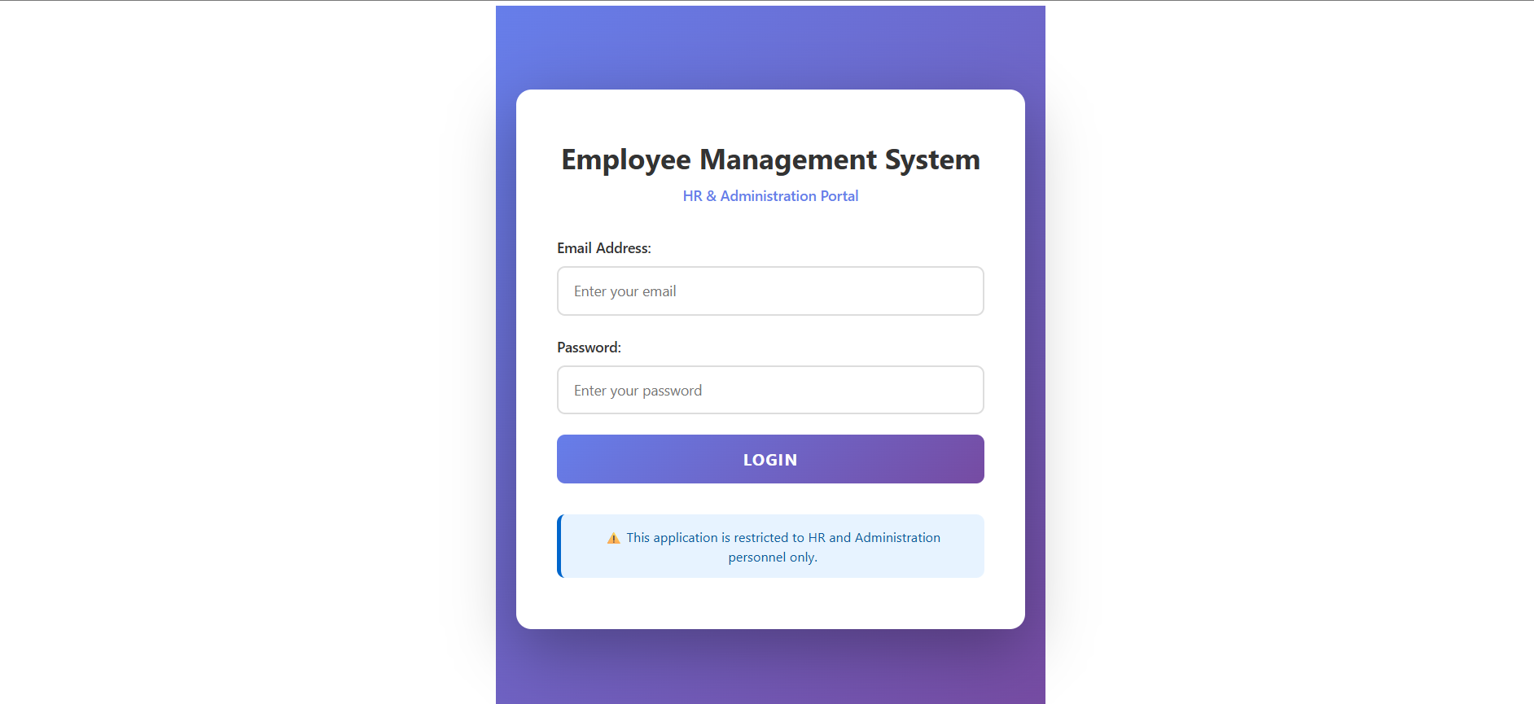
Employee Management System
Login Page:
2024 - RPS Consulting all rights reserved

Slide 13
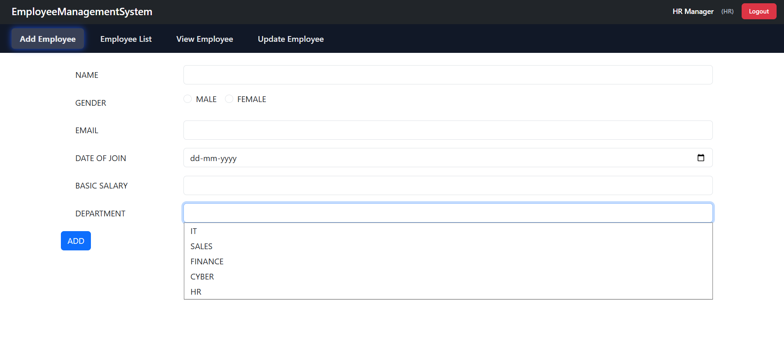
Employee Management System
Adding Employee Page:
2024 - RPS Consulting all rights reserved

Slide 14
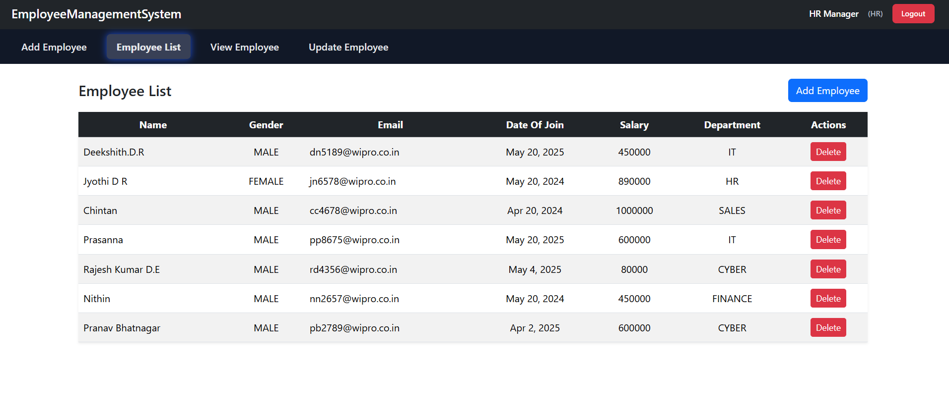
Employee Management System
Employee List Page:
2024 - RPS Consulting all rights reserved

Slide 15
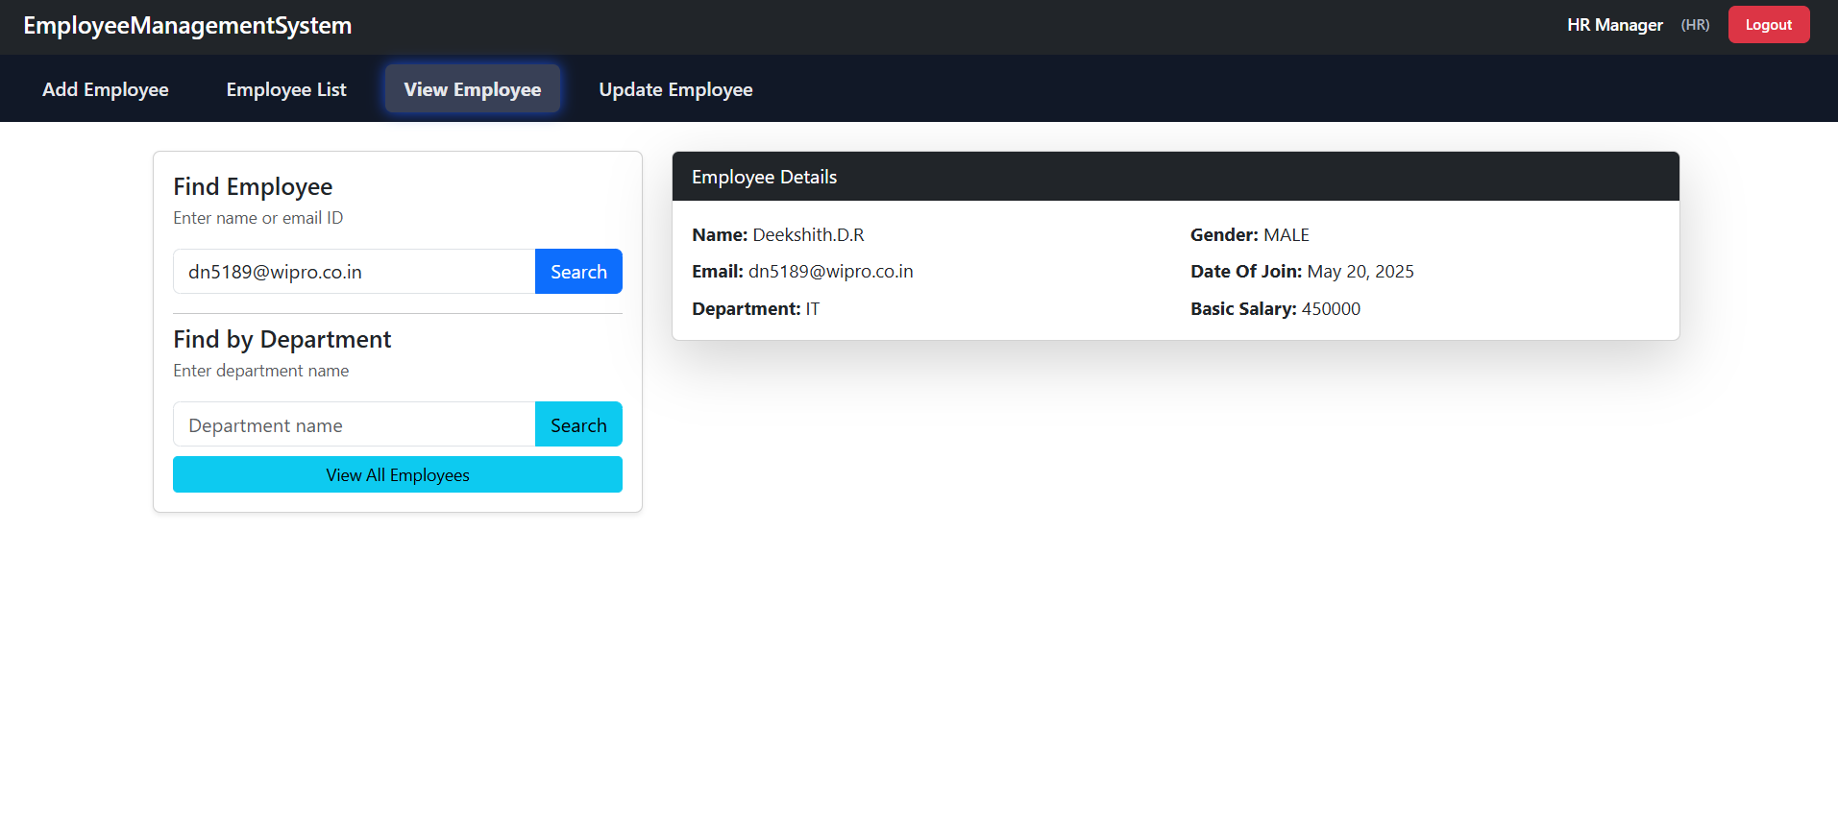
Employee Management System
Employee View(By Name or Email id) Page:
2024 - RPS Consulting all rights reserved

Slide 16
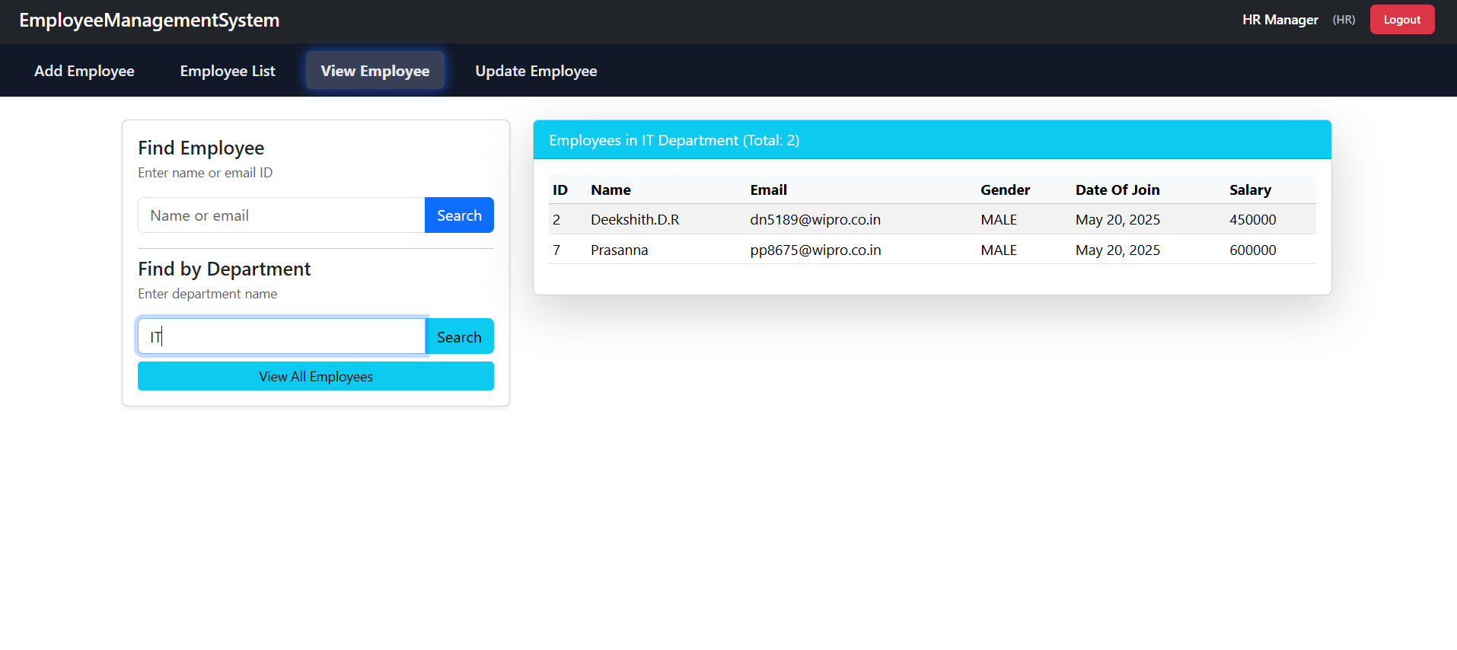
Employee Management System
Employee View(By Department) Page:
2024 - RPS Consulting all rights reserved

Slide 17
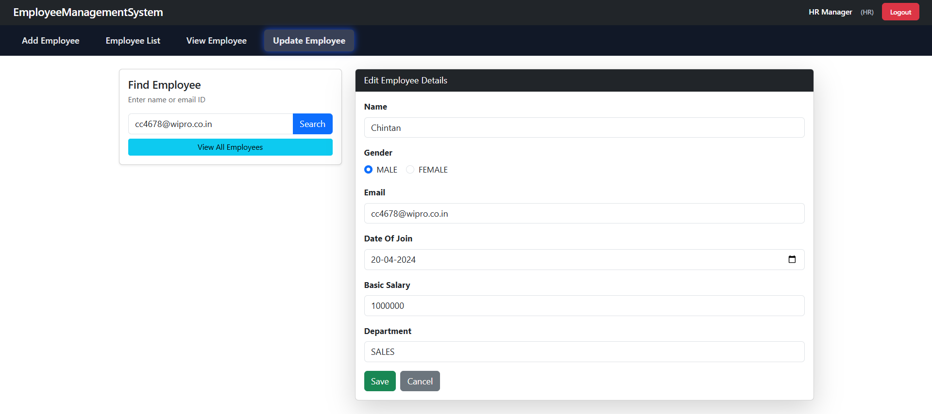
Employee Management System
Employee Update Page:
2024 - RPS Consulting all rights reserved

Slide 18
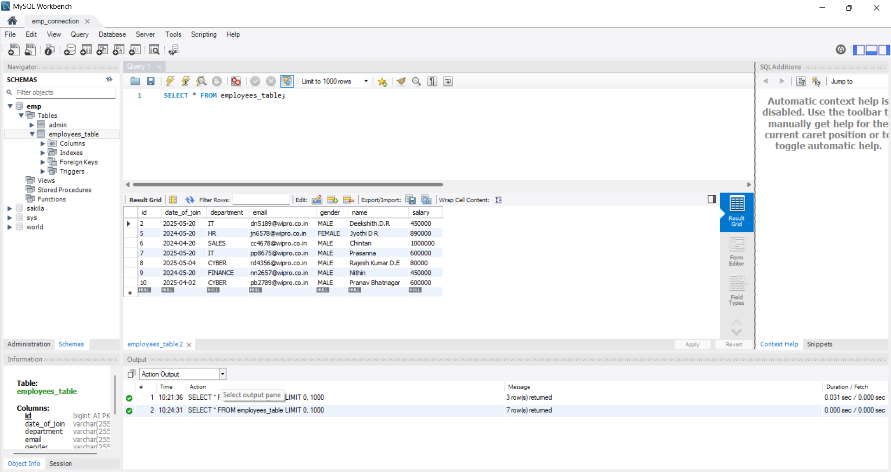
Employee Management System
Employee Data in DB :
2024 - RPS Consulting all rights reserved

Slide 19
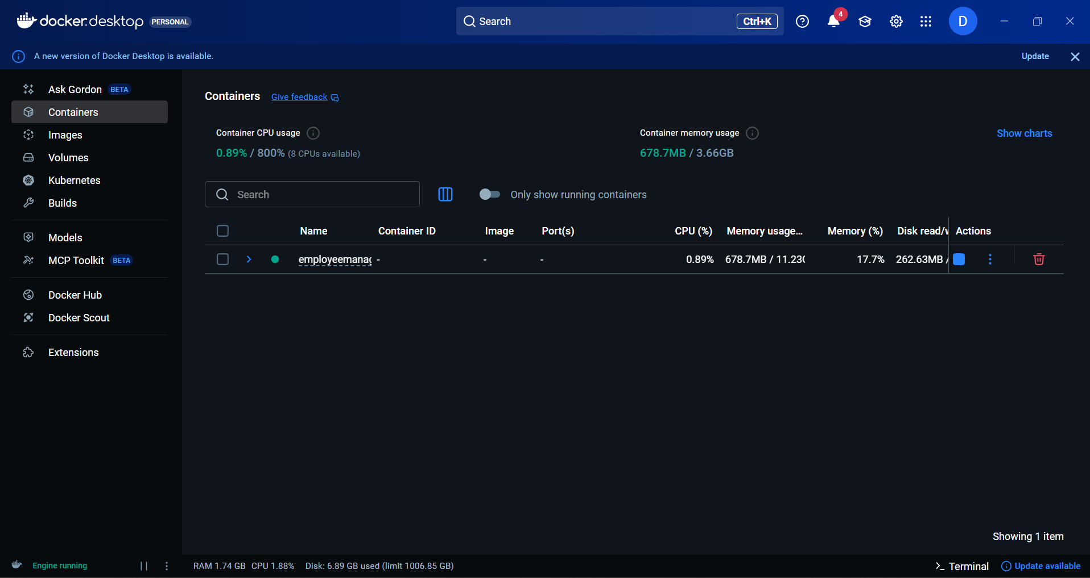
Employee Management System
Container running in Docker :
2024 - RPS Consulting all rights reserved

Slide 20
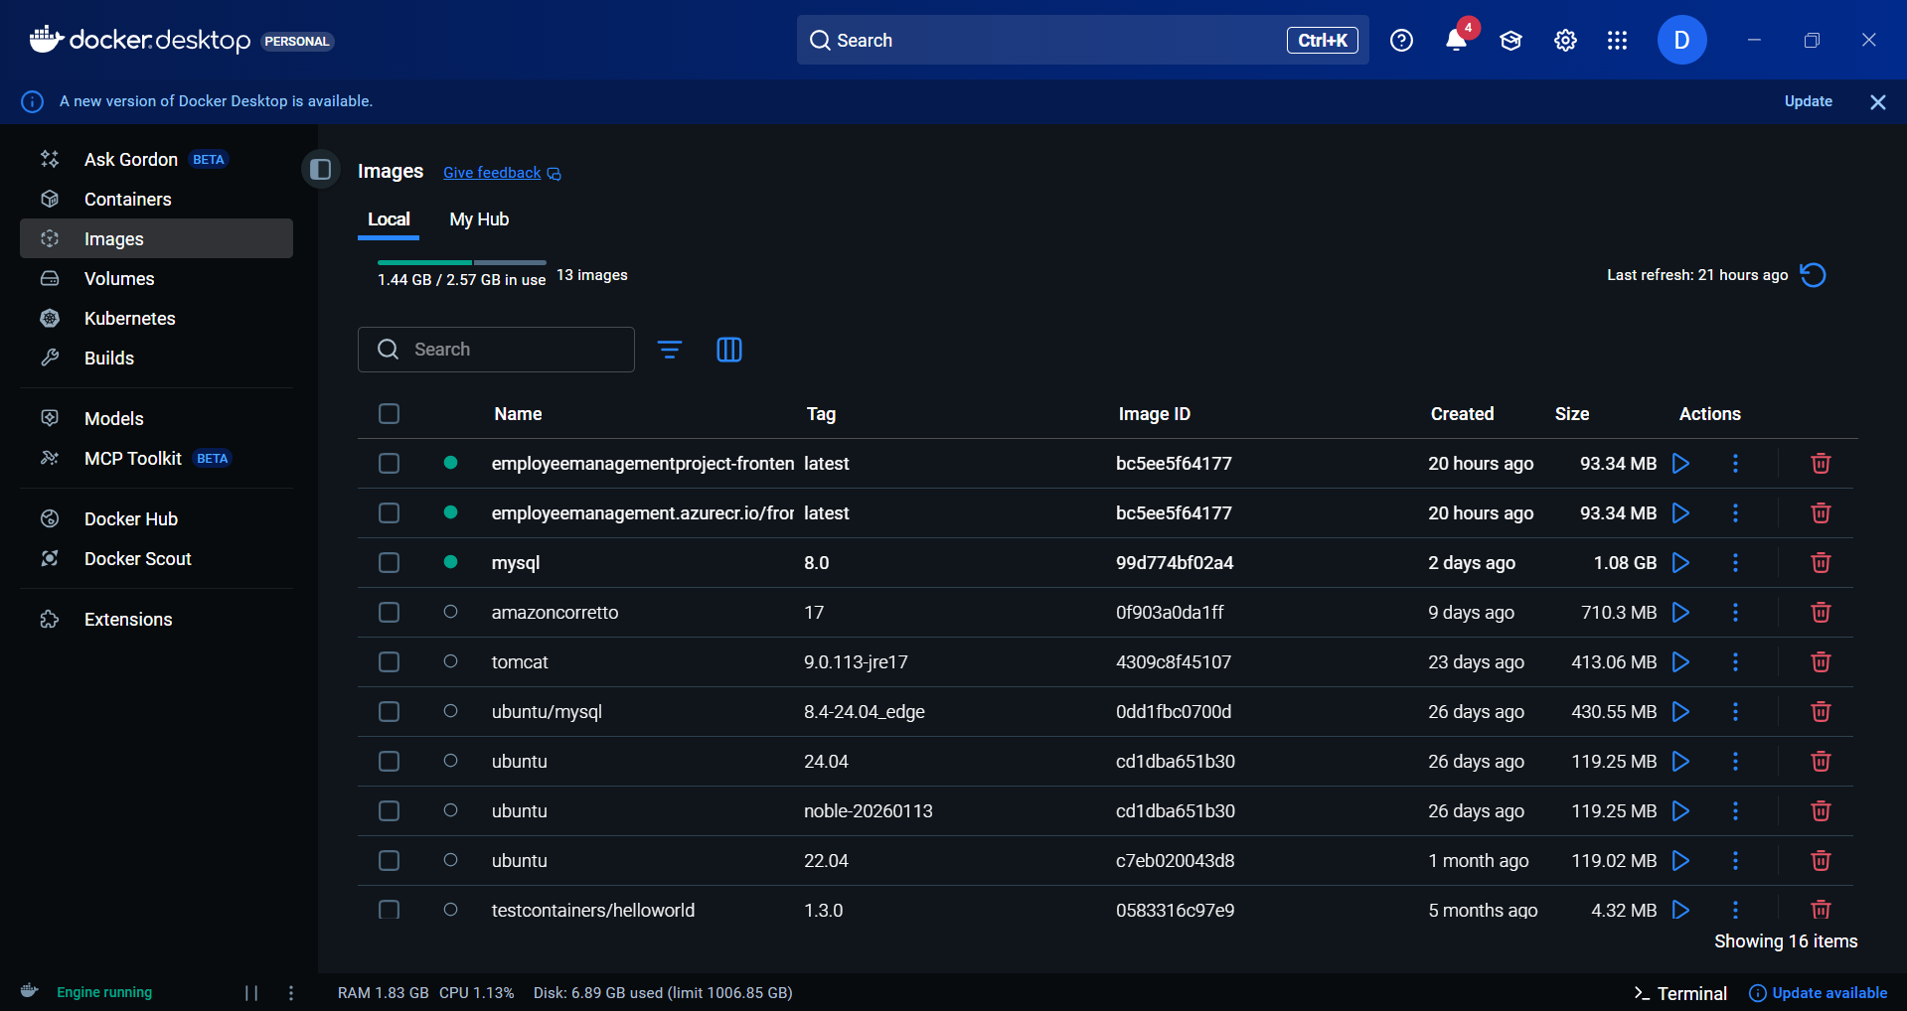
Employee Management System
Images created in Docker :
2024 - RPS Consulting all rights reserved

Slide 21
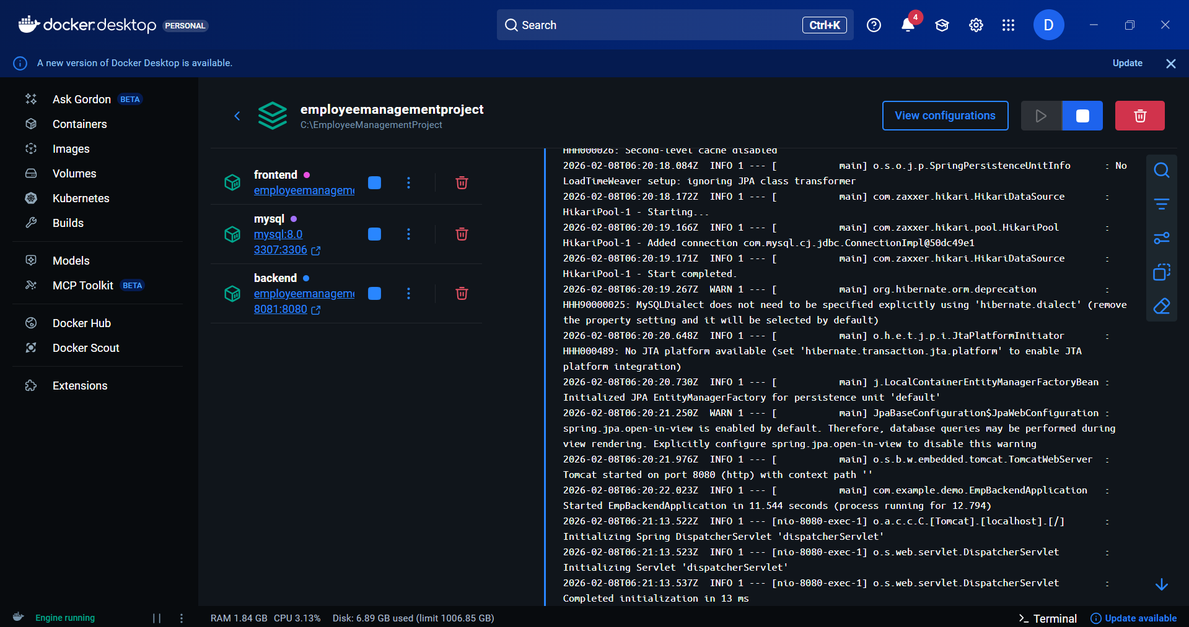
Employee Management System
3 images running inside container in Docker :
2024 - RPS Consulting all rights reserved

Slide 22
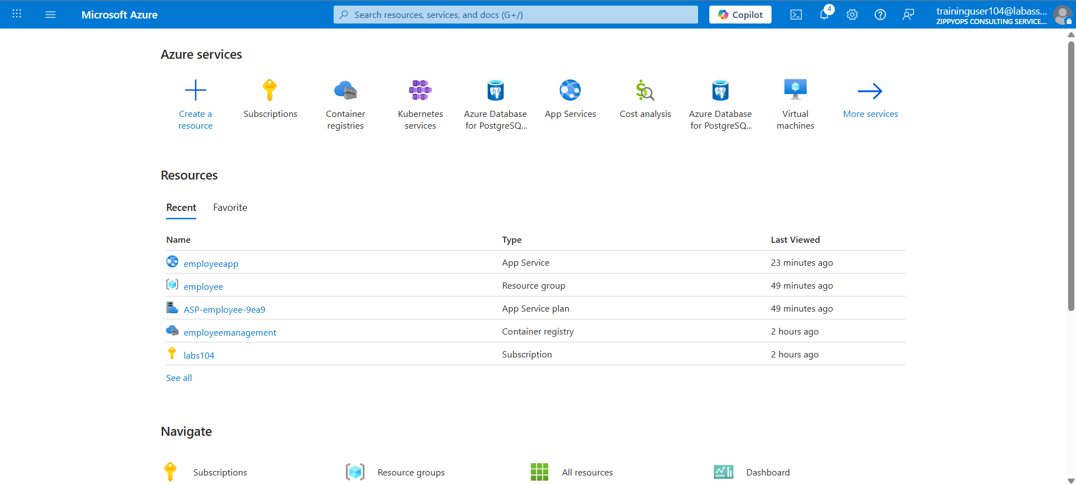
Employee Management System
Created Appservice in Azure:
2024 - RPS Consulting all rights reserved

Slide 23
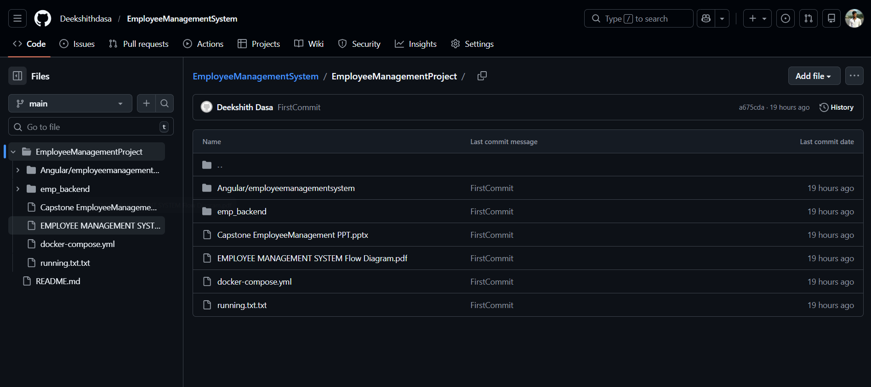
Employee Management System
Project pushed into GitHub: https://github.com/Deekshithdasa/EmployeeManagementSystem.git
2024 - RPS Consulting all rights reserved

Slide 24
Employee Management System
Conclusion:
The Employee Management System provides an efficient way to manage employee records digitally.
It supports CRUD operations with secure and validated data handling.
Angular delivers a responsive and interactive user interface.
Spring Boot with RESTful APIs handles backend business logic efficiently.
The database ensures reliable data storage and quick retrieval.
Deployment on Docker and Microsoft Azure enables scalability, reliability, and cloud readiness.
2024 - RPS Consulting all rights reserved

